Slide 1
Dr. Kanewala’s clinic
Group 6: Kelli Moore, Jordan Gallivan, Manderas Kidane, Jacob Yoast

Slide 2
The technology behind Dr. K’s clinic
Oracle SQL Developer
GitHub
Java
GUI

Slide 3
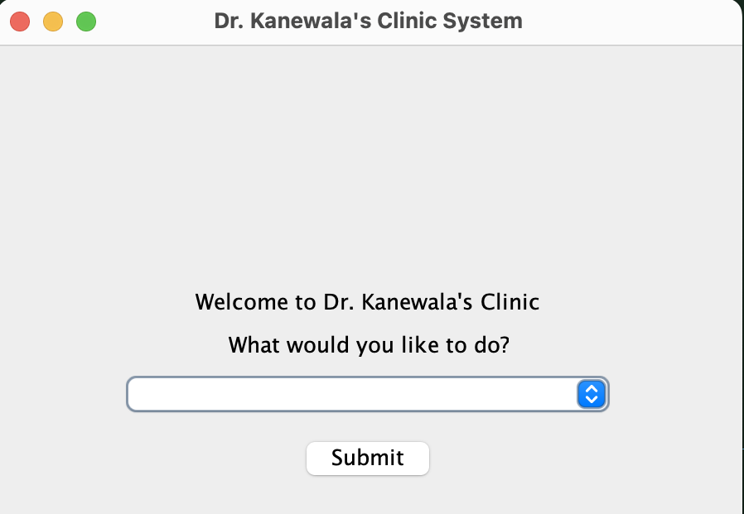
What can we achieve using these technologies?
Adding:
Editing:
Viewing:
Patient
Department
Procedure
Doctor
Medication
Interaction
Procedure done on a Patient
Medication prescribed to a Patient
Patient Health Records
Procedures offered by Departments
Procedures completed by Doctors

Slide 4
Adding

Slide 5
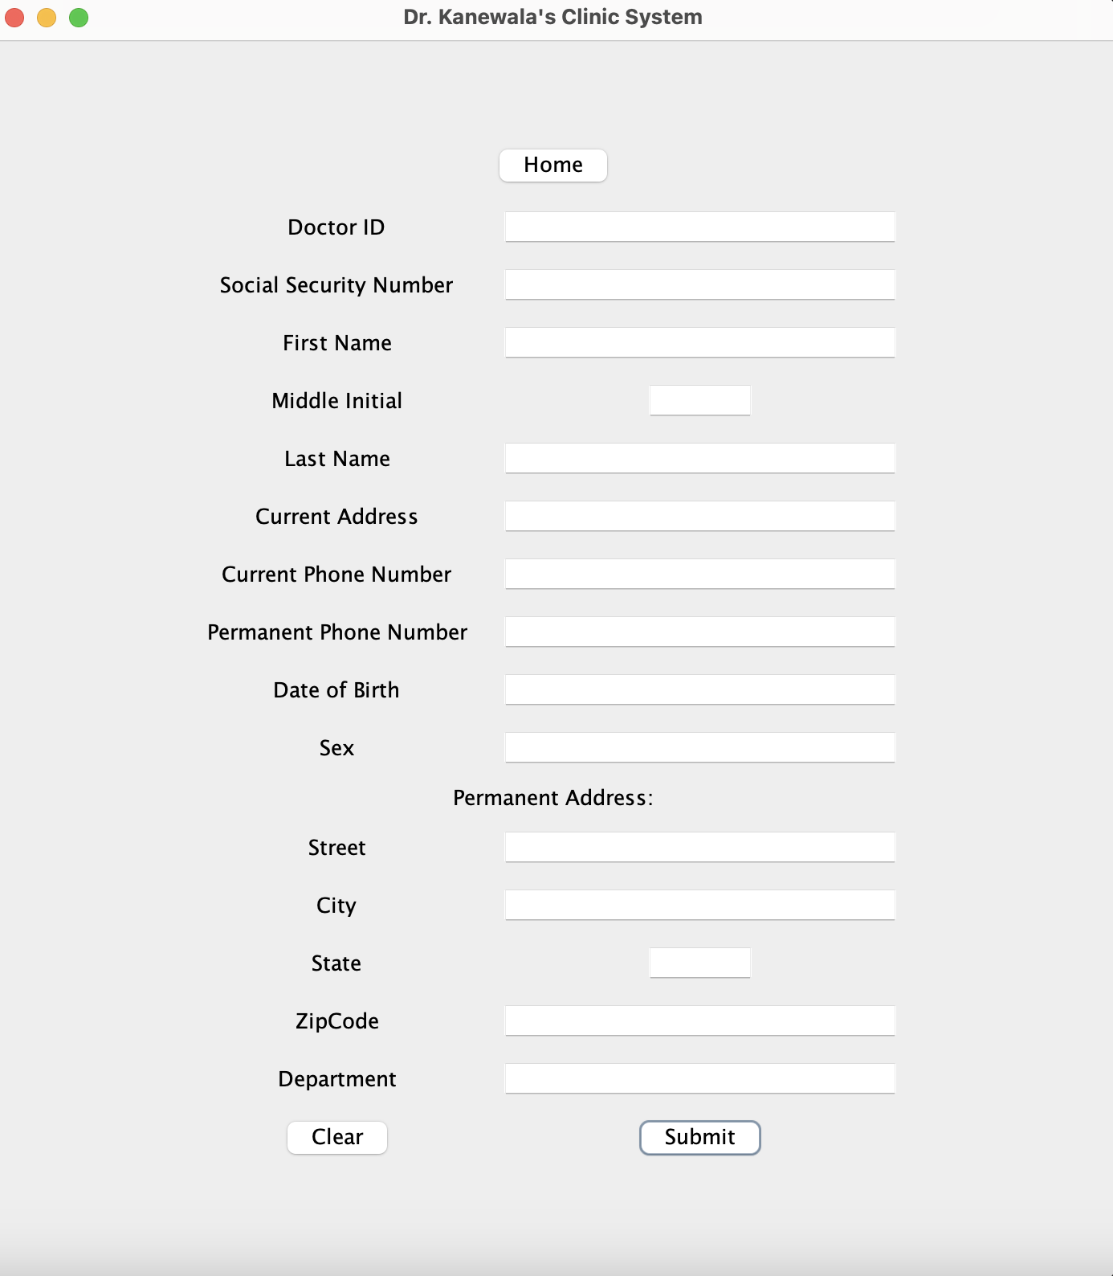

Slide 6
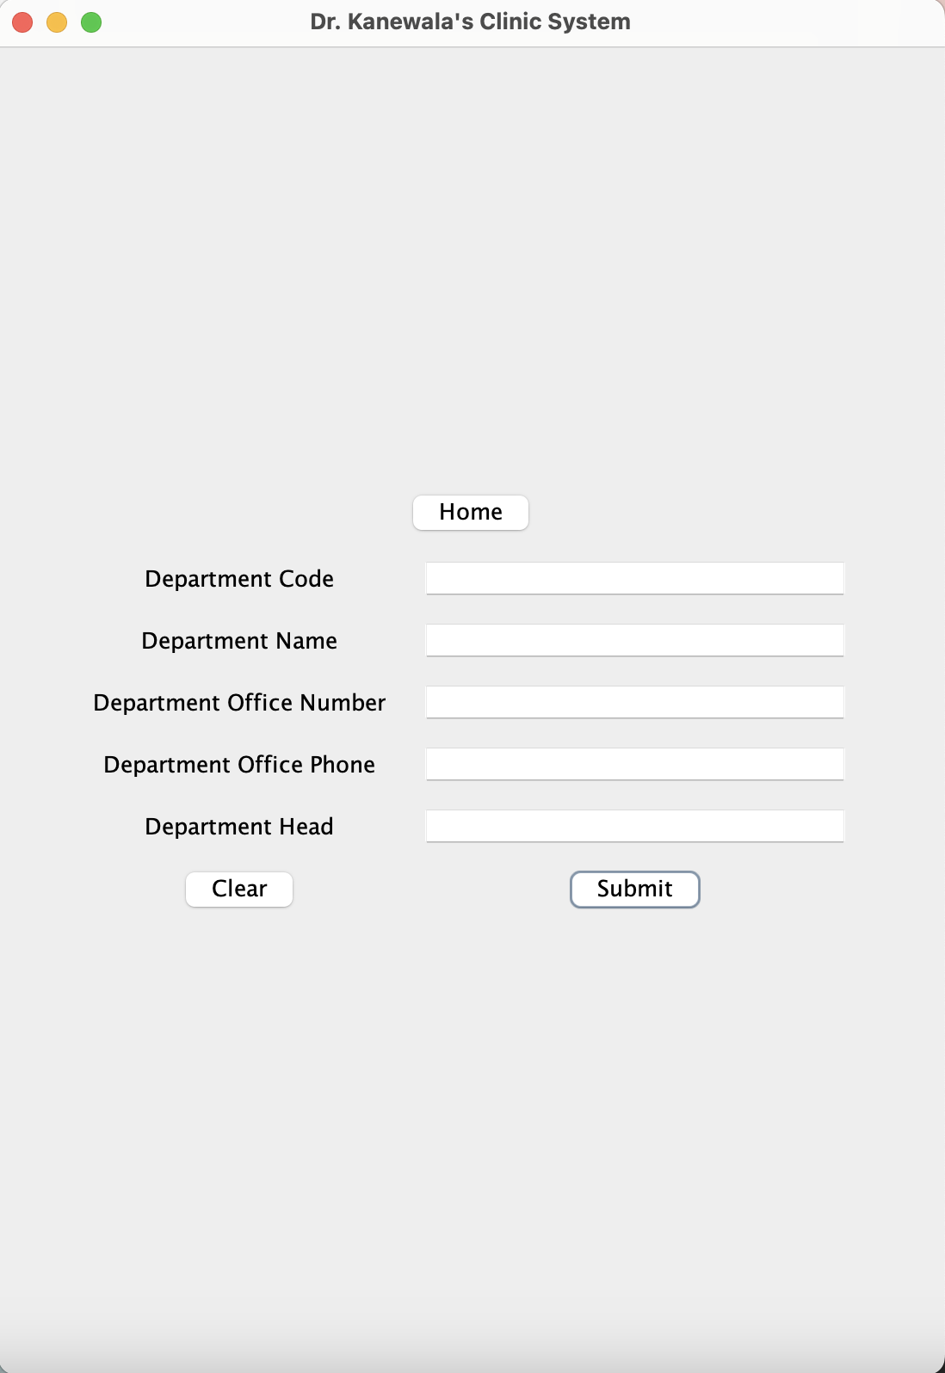
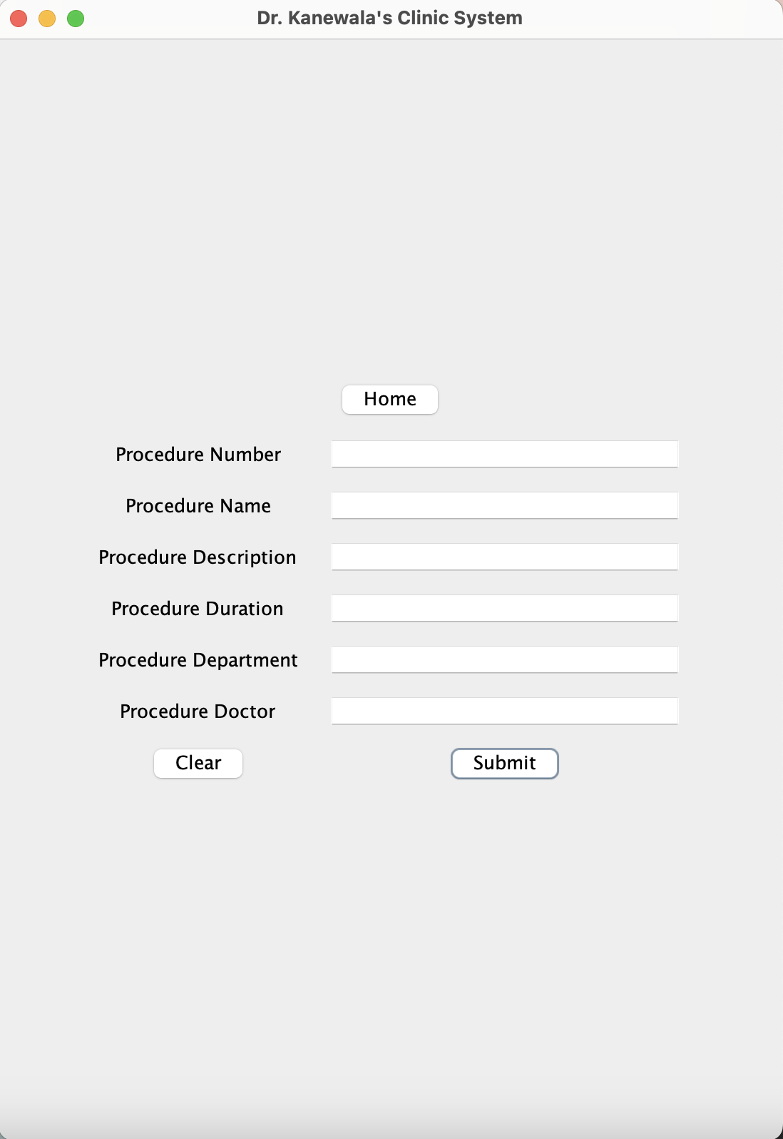
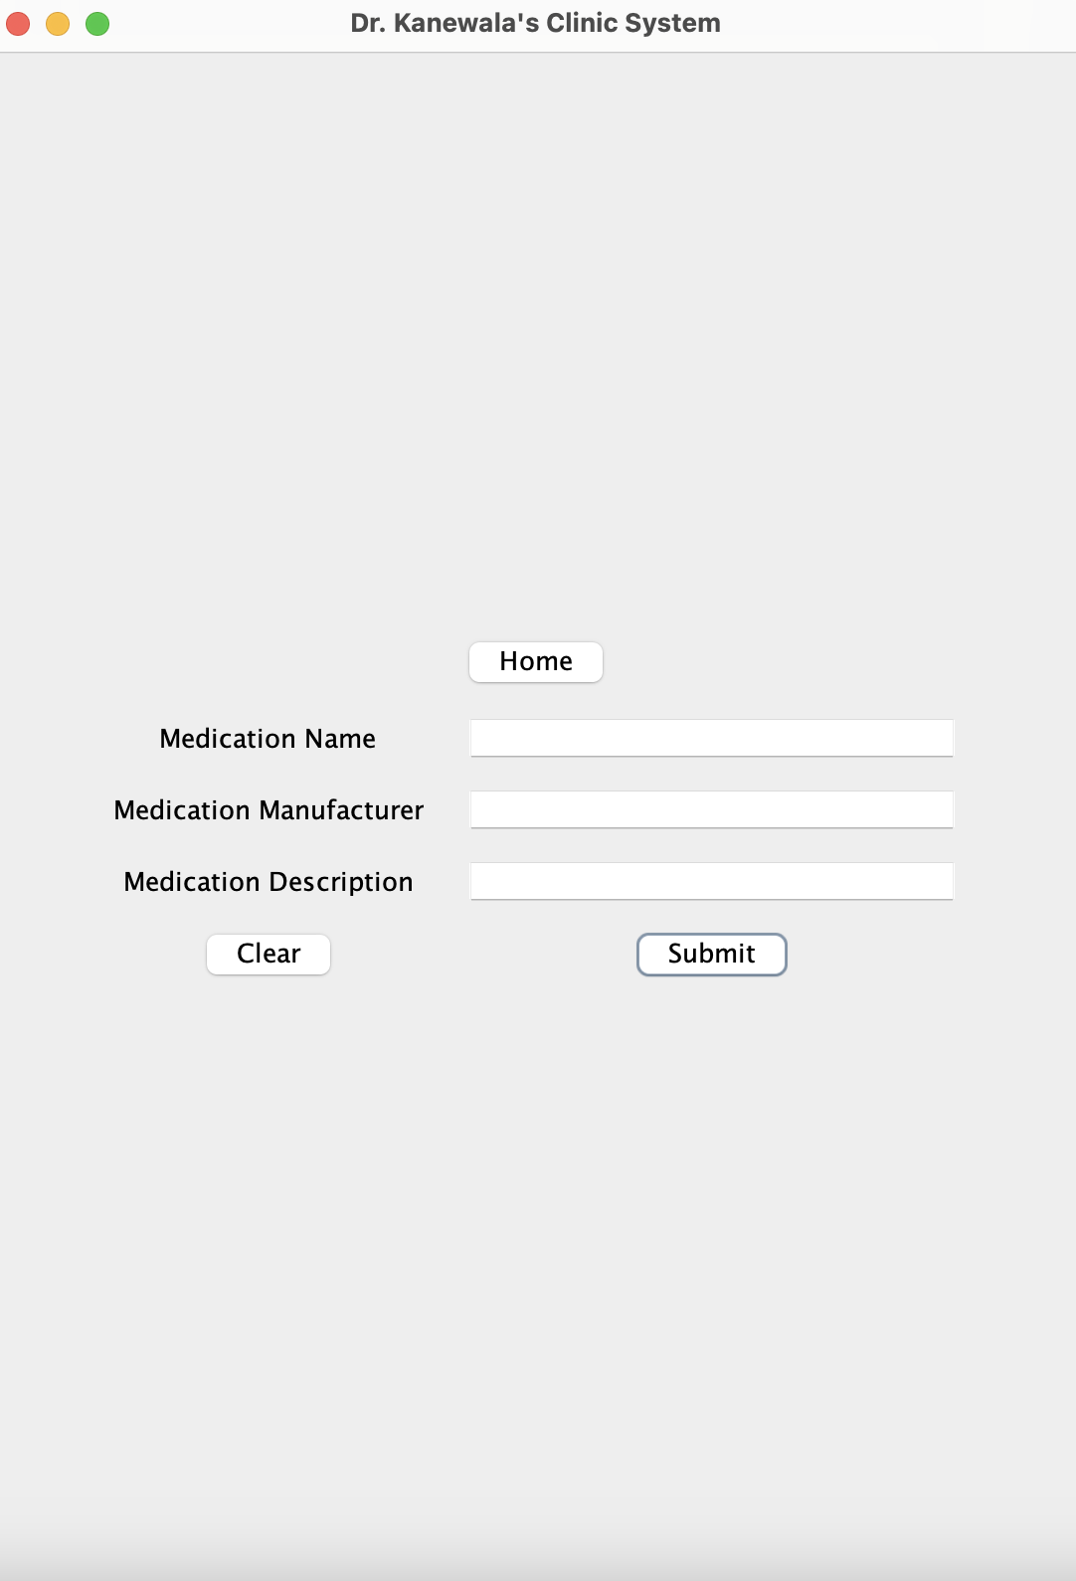
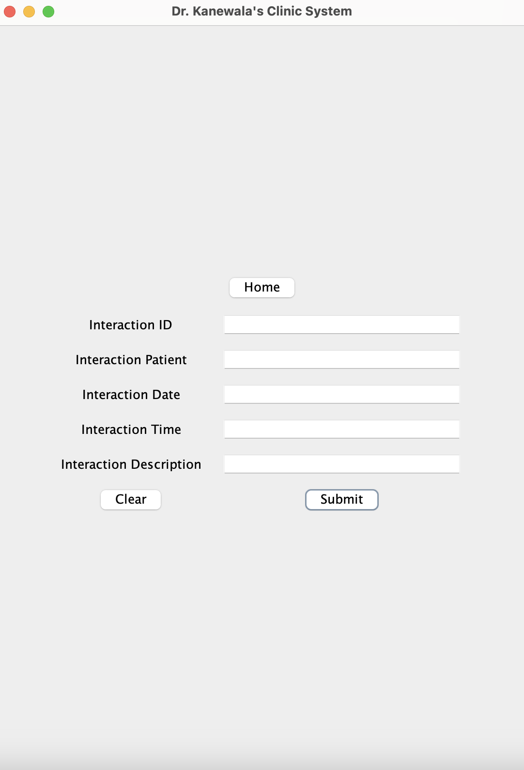

Slide 7
Editing

Slide 8
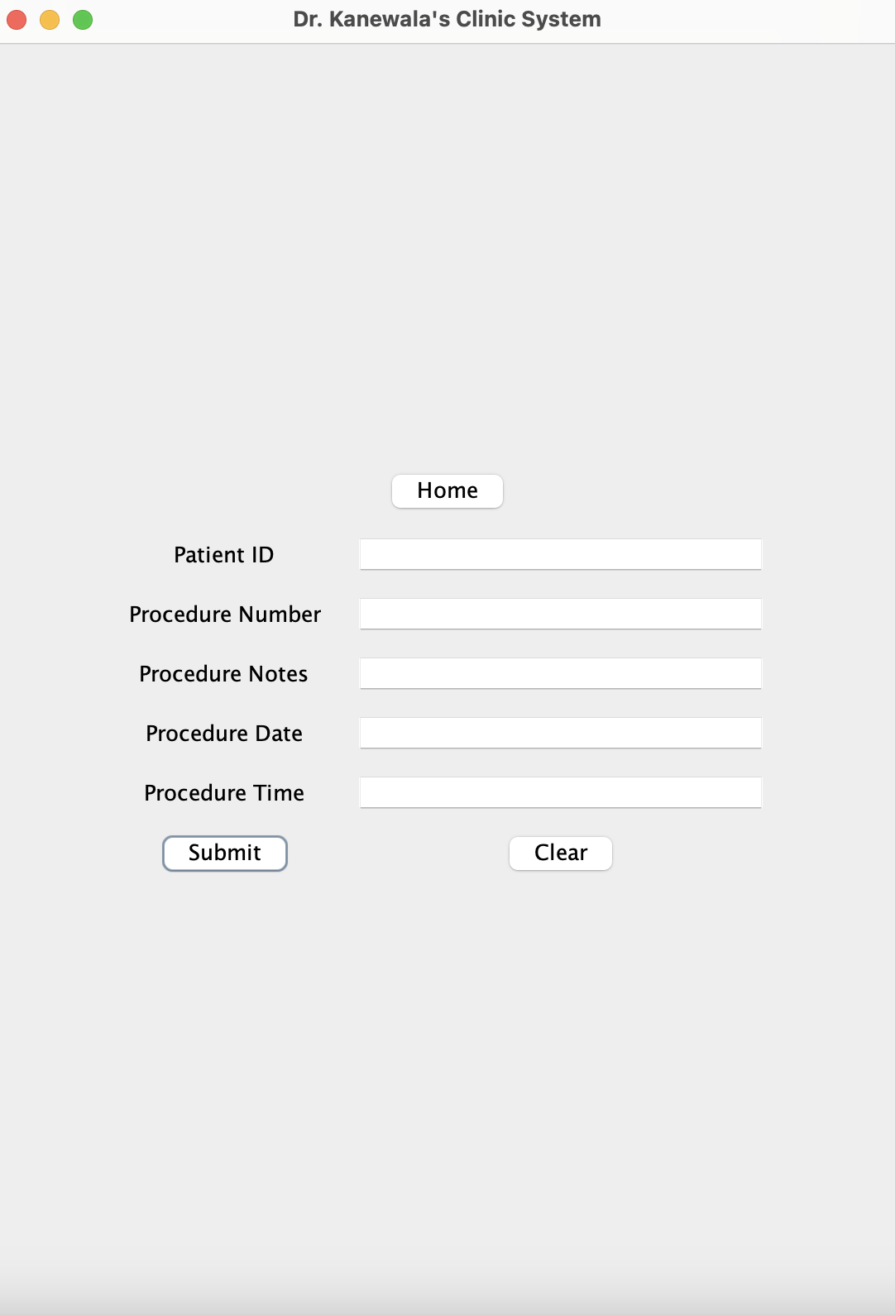
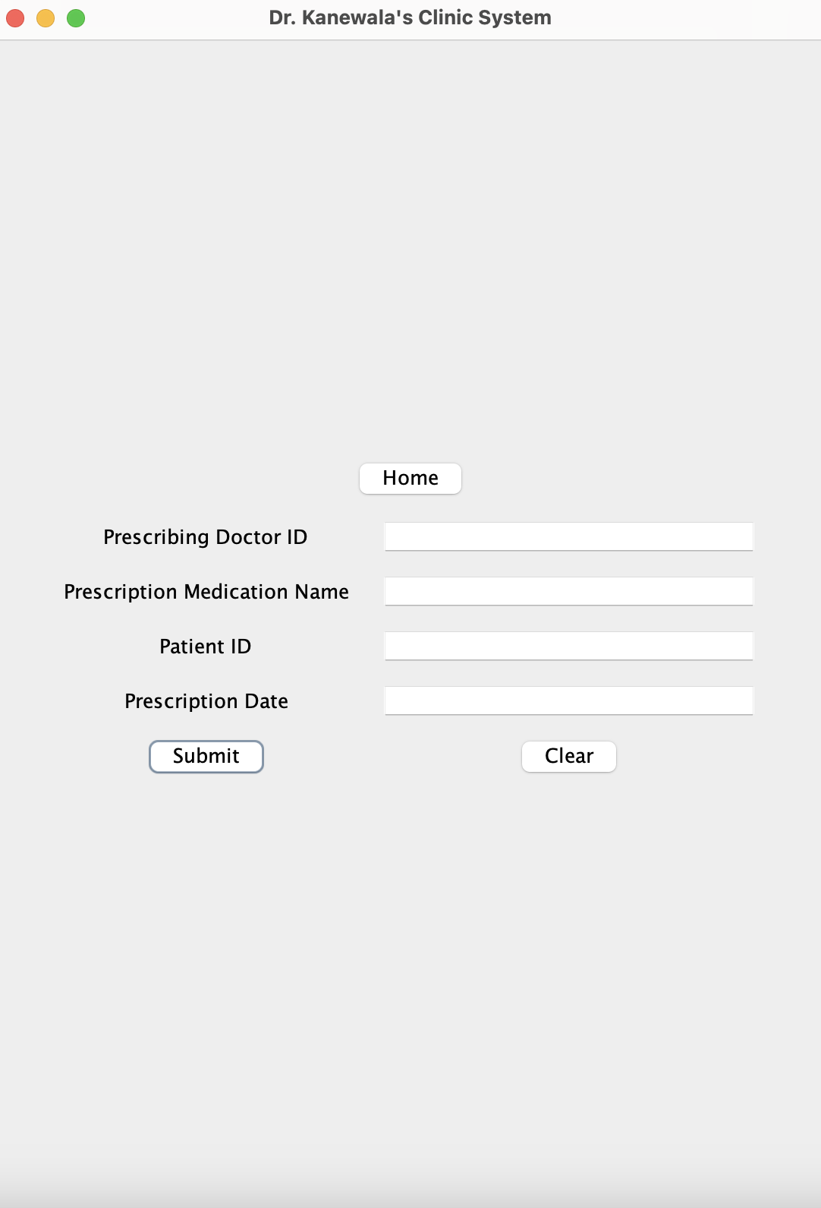

Slide 9
Viewing

Slide 10
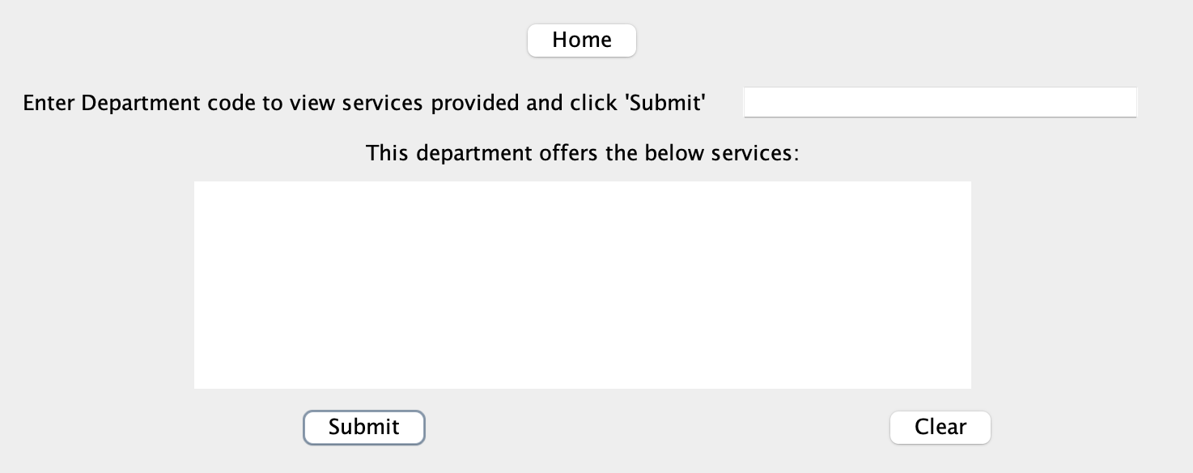
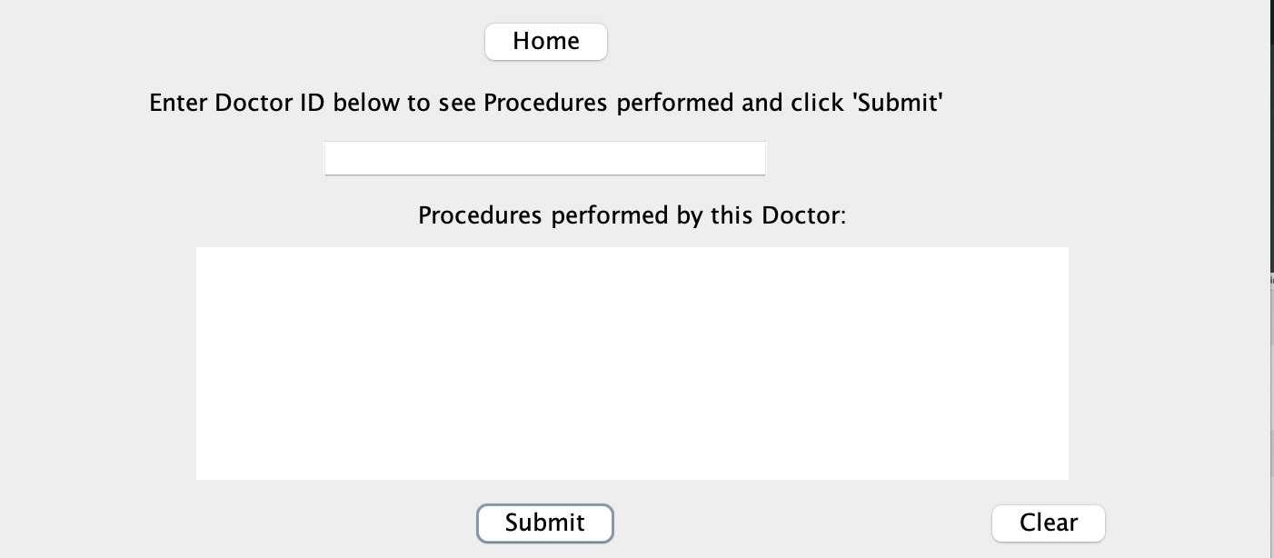
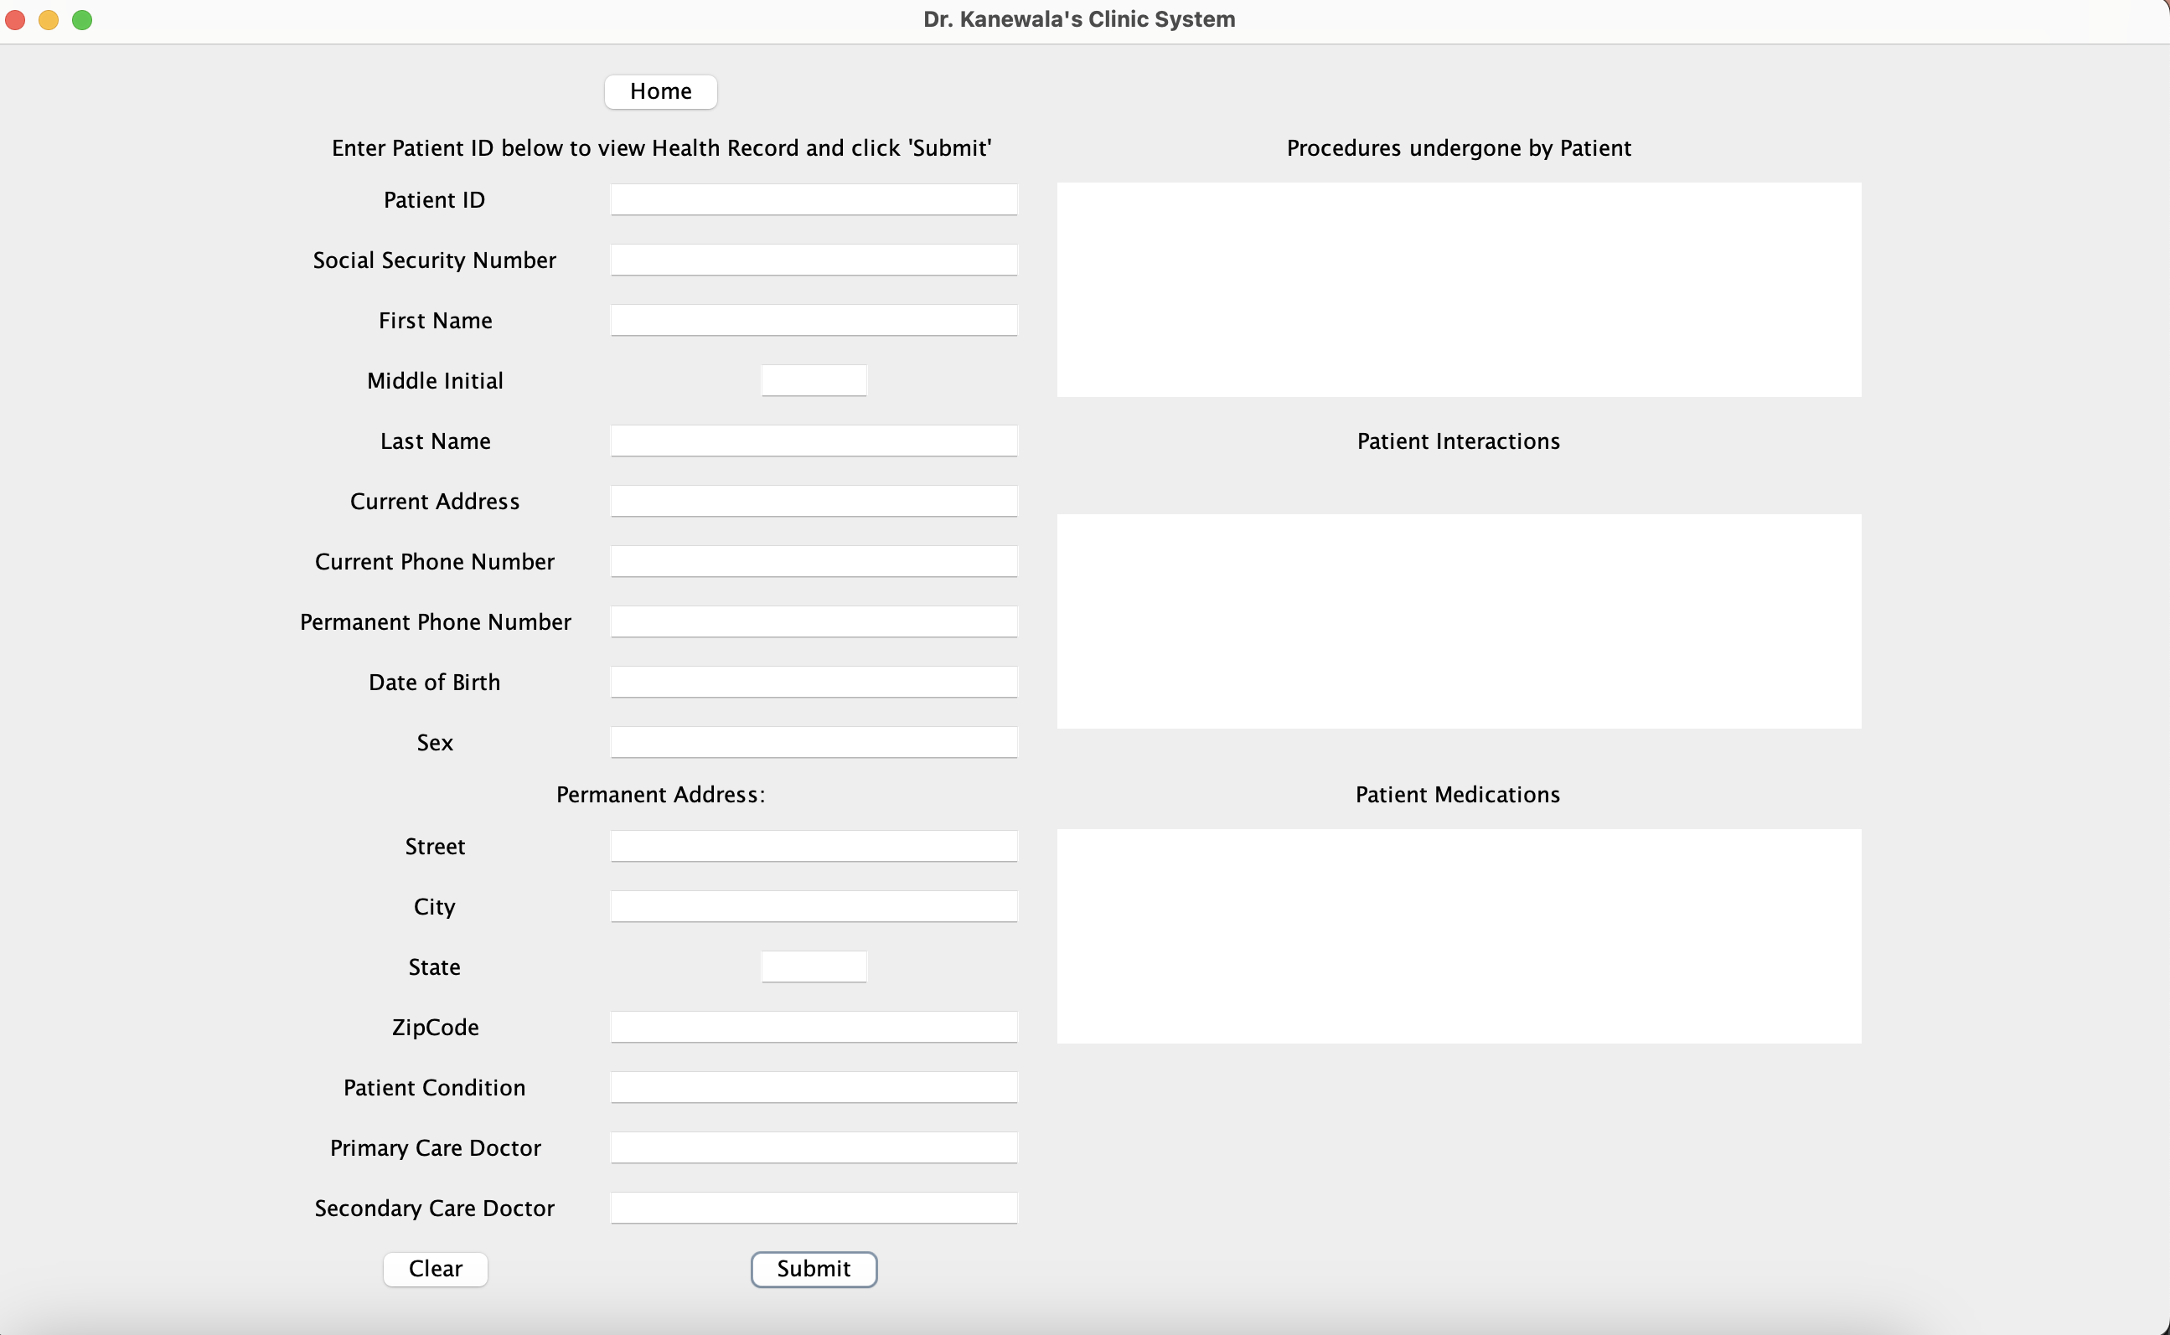

Slide 11
Demonstration

Slide 12
Questions?

